Slide 1
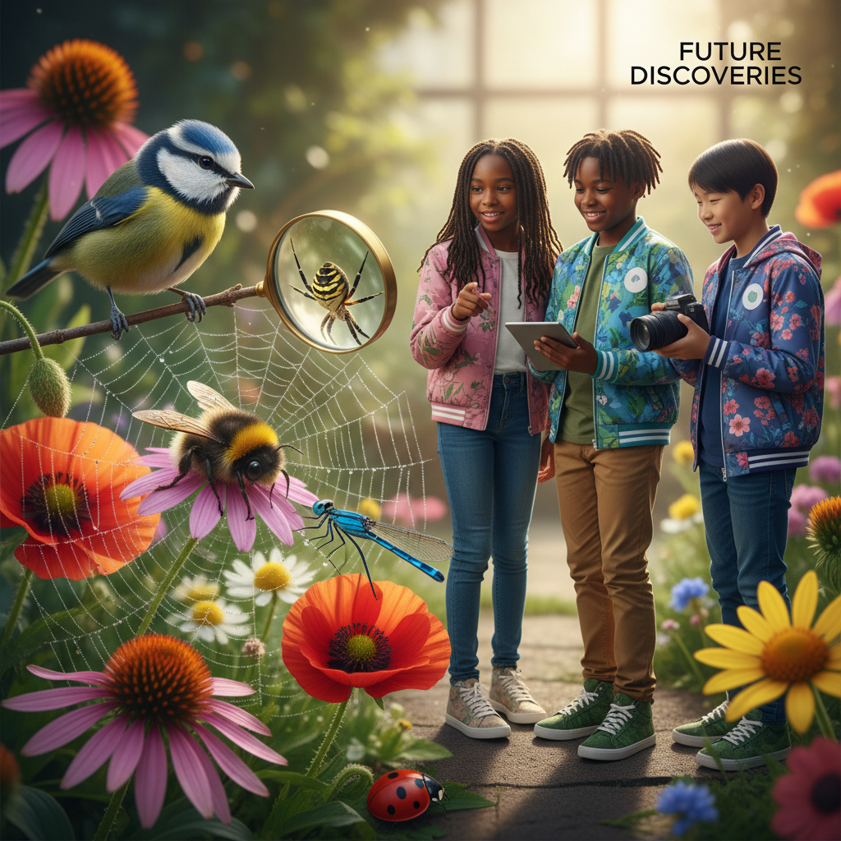
ModelIt!
Student Lesson
The Secret War in Your Backyard
How Ecosystems Balance Competition, Cooperation, and Survival
NGSS: MS-LS2-2, MS-LS2-3, MS-LS2-5
6th Grade
1/9

Slide 2
What You Will Learn Today
Learning Goals
* Explain how predator-prey relationships create population cycles in ecosystems
* Model how predator population, prey population, habitat size, and resource availability interact
* Predict what happens to an ecosystem when one population is removed or dramatically changed
* Evaluate strategies for maintaining biodiversity in threatened ecosystems
Key Vocabulary
Ecosystem
A community of living organisms interacting with each other and their nonliving environment
Biodiversity
The variety of different species in an ecosystem — more biodiversity generally means a healthier ecosystem
Carrying Capacity
The maximum population size an environment can sustain given available food, water, and space
Trophic Level
An organism's position in a food chain — producers, primary consumers, secondary consumers, decomposers
2/9

Slide 3
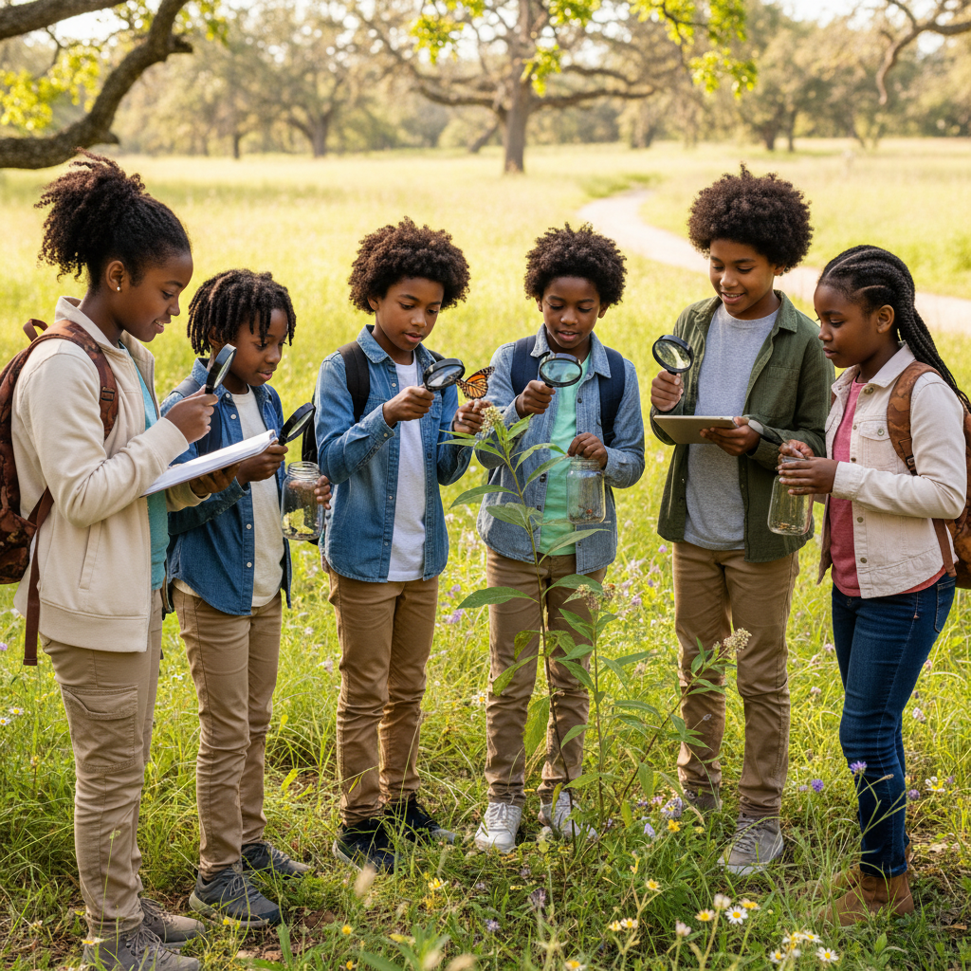
The Big Question
Even a tiny backyard is a hidden battlefield — how do organisms compete, cooperate, and survive in a complex ecosystem?
How Ecosystems Balance Competition, Cooperation, and Survival. Today we'll build a MODEL to discover the answer!
3/9

Slide 4

Today We Will Build a Model!
A model helps us understand complex systems!
1. LOCATE
Identify the COMPONENTS (parts) of the system
2. ESTABLISH
Connect them with RELATIONSHIPS (+ or -)
3. VISUALIZE
Build your model in ModelIt!
4. EVALUATE
Run SIMULATIONS to test scenarios
5. REVISE
Improve your model based on evidence
4/9

Slide 5

Activity 1: Sort the Components
Sort these components into EXTERNAL (inputs from outside) and INTERNAL (inside the system):
Your Components:
* Predator Population
* Prey Population
* Habitat Size
* Resource Availability
Think: Which components can we control? Which happen on their own?
5/9

Slide 6
Activity 2: Connect with Arrows
Draw arrows to show HOW components affect each other:
(+) POSITIVE Relationship
When one goes UP, the other goes UP too
(-) NEGATIVE Relationship
When one goes UP, the other goes DOWN
Think About It:
When prey population increases, what happens to predator population? And when predator population increases, what happens to prey? Do these relationships create a cycle?
6/9

Slide 7
Activity 3: Run the Simulation!
Test these scenarios in ModelIt!
Balanced Ecosystem
Set all components to moderate levels and observe population cycles over time
Predator Removal
Lock Predator Population to zero and observe what happens to prey and resources
Habitat Loss
Cut Habitat Size to 25% and observe how both populations respond
Watch the activity graphs change!
[ModelIt Platform Screenshot - Simulation Results Graph]
7/9

Slide 8
What Did We Discover?
Our Model Showed Us:
* Predator and prey populations naturally cycle — when prey increases, predators follow, then prey crashes, then predators crash
* Removing predators causes prey to overshoot carrying capacity, depleting resources and causing a population crash
* Habitat loss reduces carrying capacity for ALL species, often pushing the smallest populations to extinction first
* Biodiversity makes ecosystems more resilient — diverse ecosystems recover from disturbances faster than simple ones
Answer: Your backyard is a battlefield of constant competition and cooperation. Predators control prey populations, prey control plant populations, and decomposers recycle everything. These interactions create a dynamic balance. When humans disrupt that balance — by removing predators, shrinking habitat, or introducing invasive species — the entire ecosystem can collapse like a chain of dominoes.
8/9

Slide 9

STEM Challenge: Design a Biodiversity Rescue Plan
YOUR ENGINEERING MISSION
Design an evidence-based plan to restore biodiversity in a degraded ecosystem, using your model to predict which interventions will be most effective.
The Challenge:
A local nature preserve has lost 60% of its habitat to development. Deer populations have exploded without wolves, overgrazing vegetation. Bird species are declining, and the stream ecosystem is degrading. Your ecology team must design a restoration plan using model evidence.
Think Like an Engineer:
* Based on your model, which single intervention would have the greatest positive impact on biodiversity?
* Should predators be reintroduced? What does your model predict will happen?
* How much habitat must be restored to support a balanced ecosystem?
REAL CAREER CONNECTION: Conservation Biologists and Ecologists study ecosystems to protect biodiversity and restore degraded habitats. They develop strategies that balance human needs with environmental health. They earn $55,000–$110,000/year. The skills you're using TODAY are the same ones they use on the job!
9/9

